Slide 1
Chapter 6.1 Code Refactoring (Bad Smells)
CCSW 325 (Software Construction)
Notes:
Last Update: 22/8/2019
Version 1.0

Slide 2
Outline
What is Refactoring?
Composing Methods
Extract Method
Replace Temp with Query
Introduce Explaining Variable
Split Temporary Variable
Remove Assignments to Parameters

Slide 3
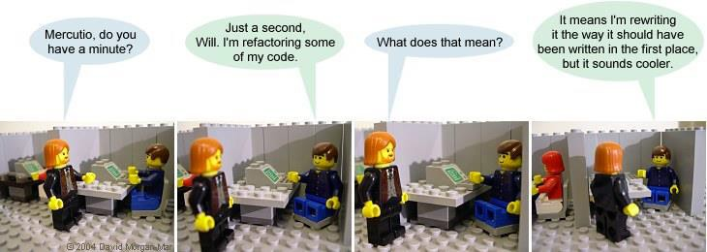
What is Refactoring?
Modifying software code to improve its readability, maintainability, and extensibility without changing what it actually does.
External behavior does NOT change
Internal structure is improved

Slide 4

What is Refactoring? (cont.)
It is a disciplined way to clean up code that minimizes the chances of introducing bugs.

Slide 5

What is Refactoring? (cont.)
In essence when you refactor you are improving the design of the code after it has been written.
In software development, we design first then we code
Refactoring is the opposite of this practice: take a bad design, and rework it into well-designed code

Slide 6
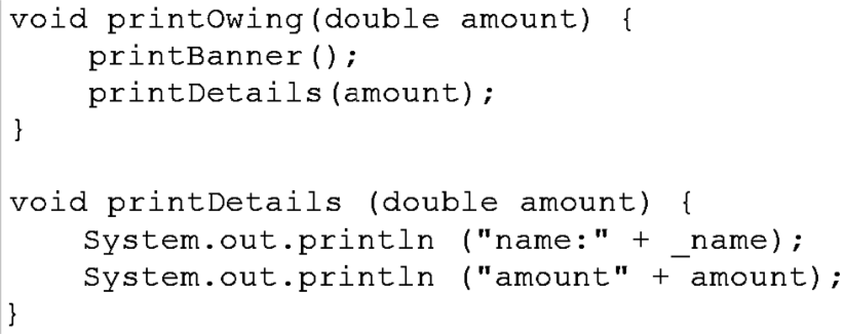
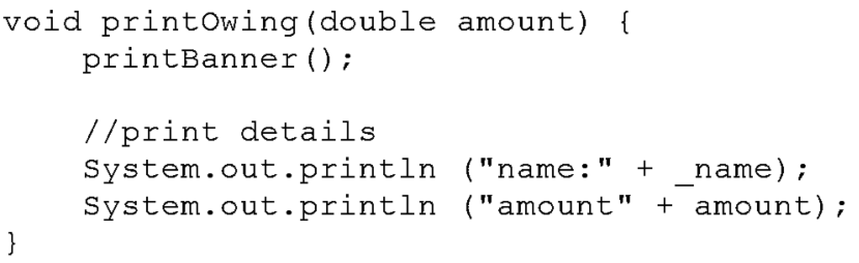
Composing Methods – Extract Method
You have a code fragment that can be grouped together.
Turn the fragment into a method whose name explains the purpose of the method.

Slide 7
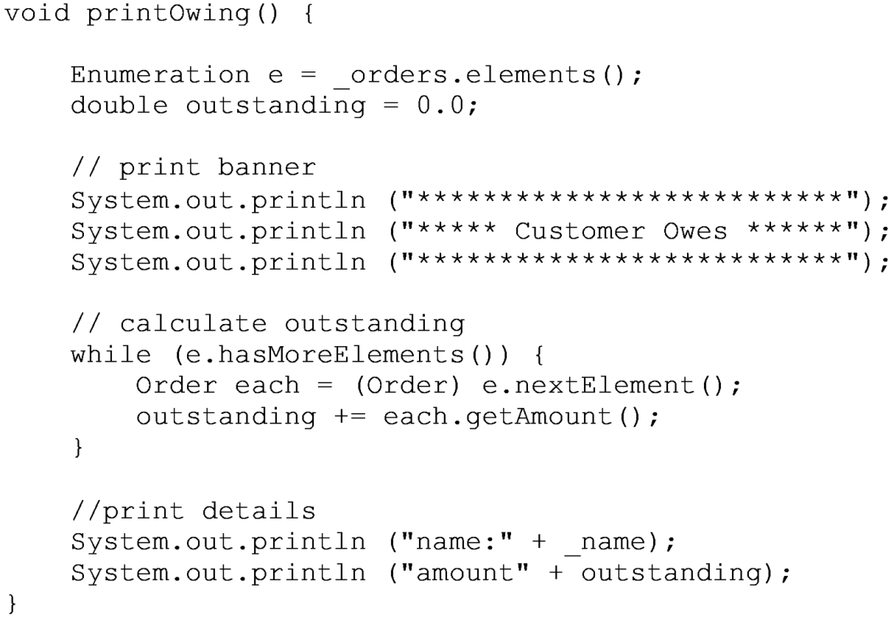
Composing Methods – Extract Method

Slide 8
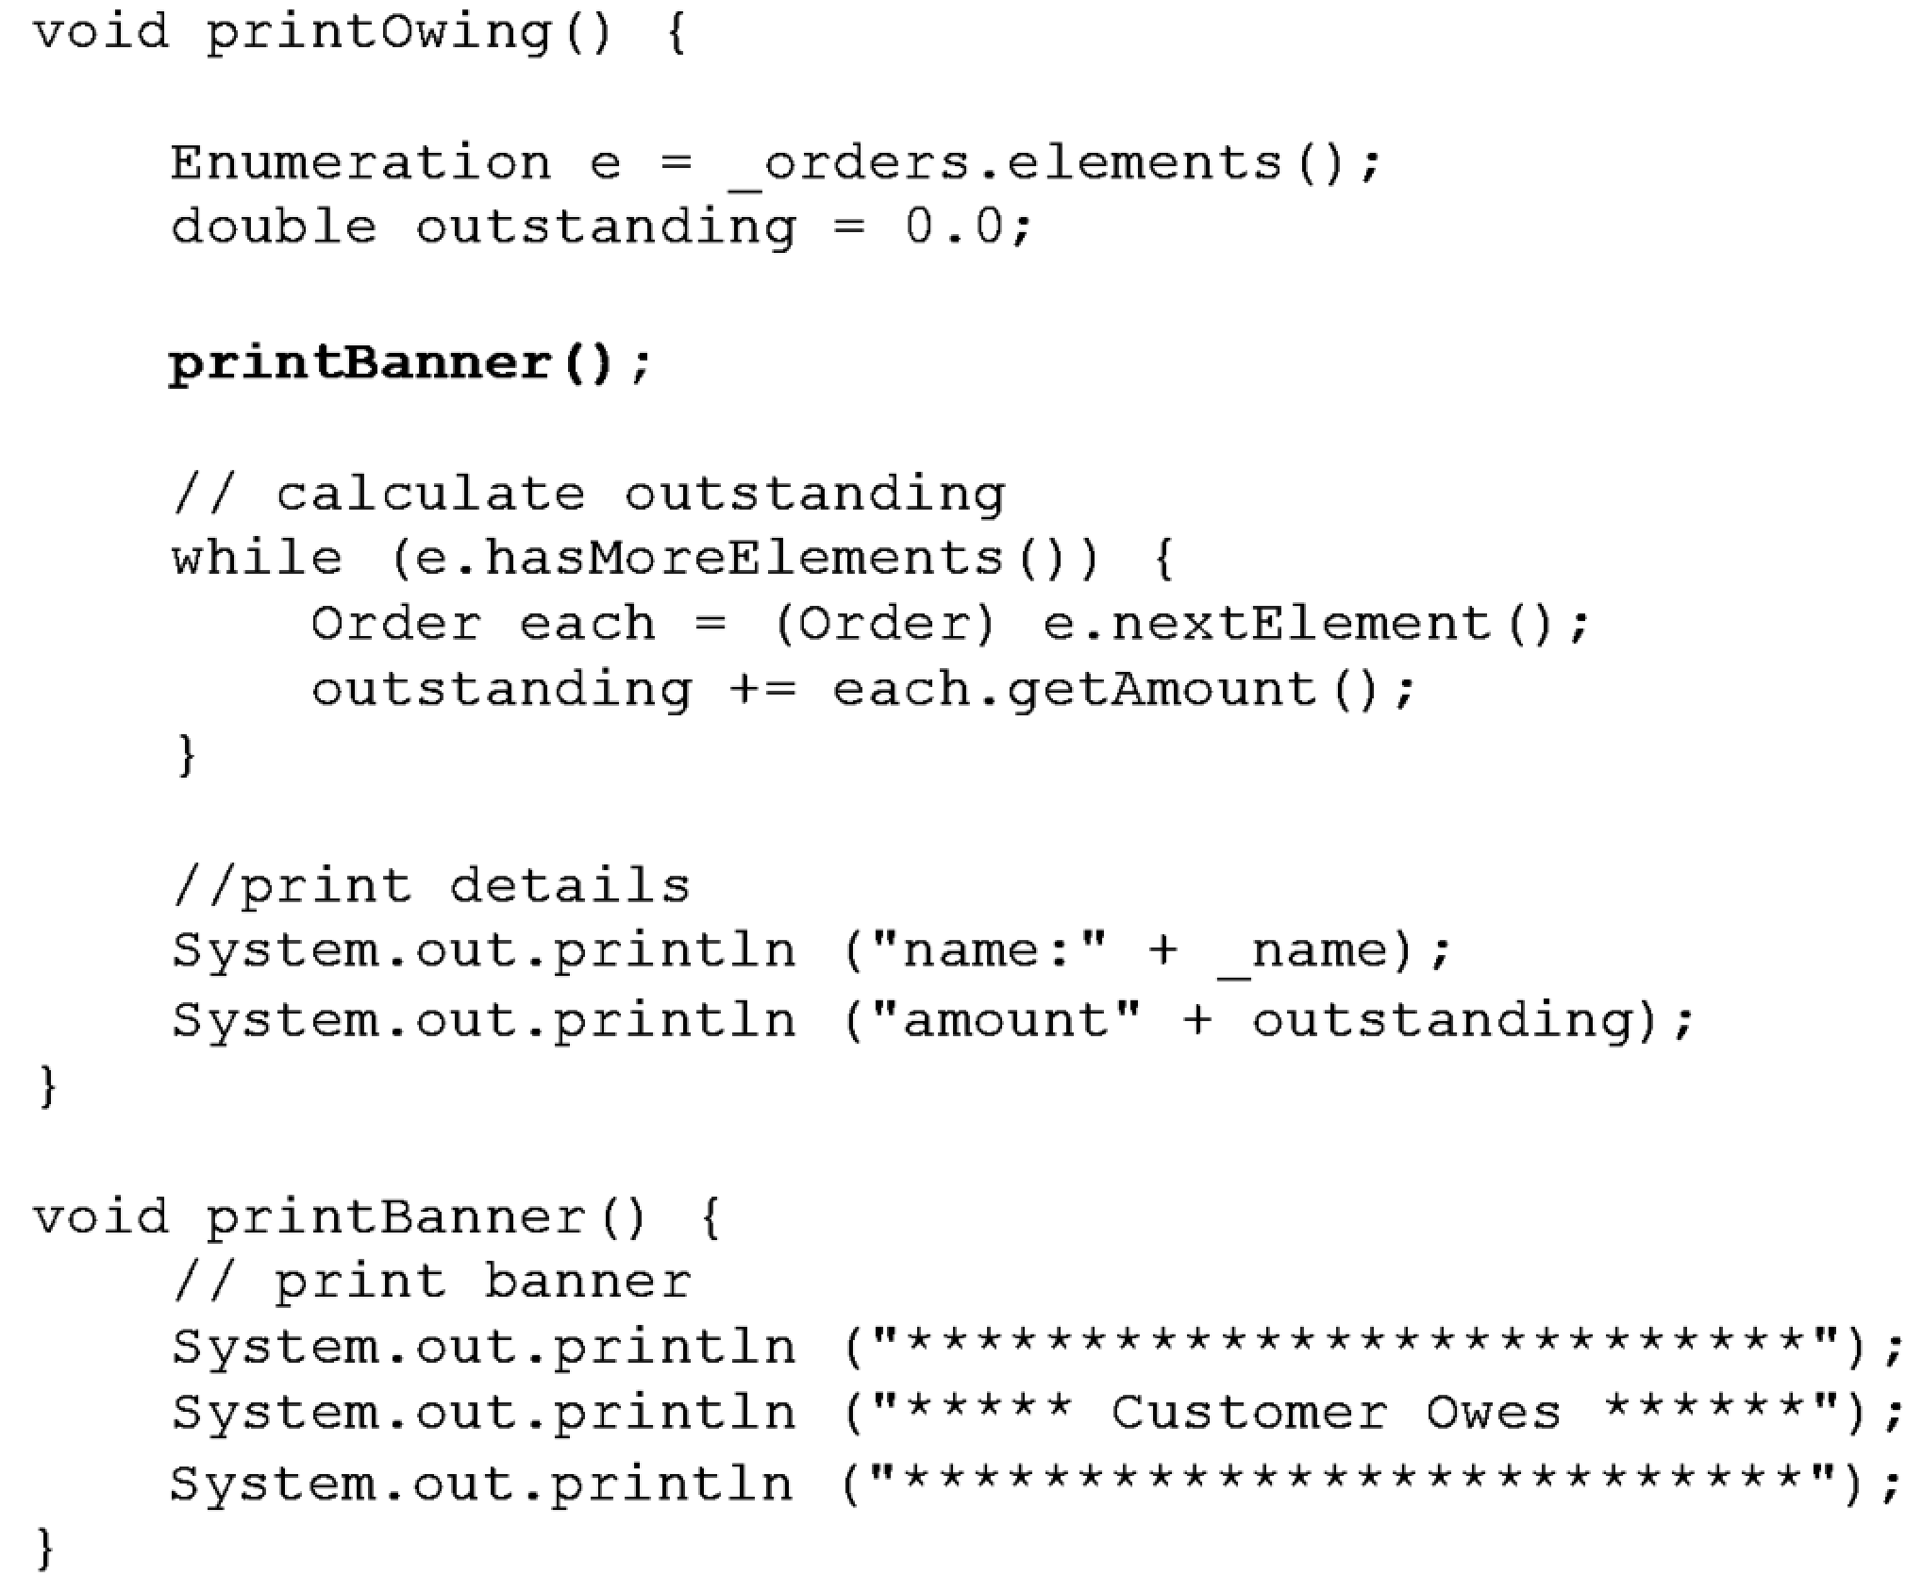
Composing Methods – Extract Method
Example: No Local Variables
Extract the code that prints the banner. Just cut, paste, and put in a call:

Slide 9
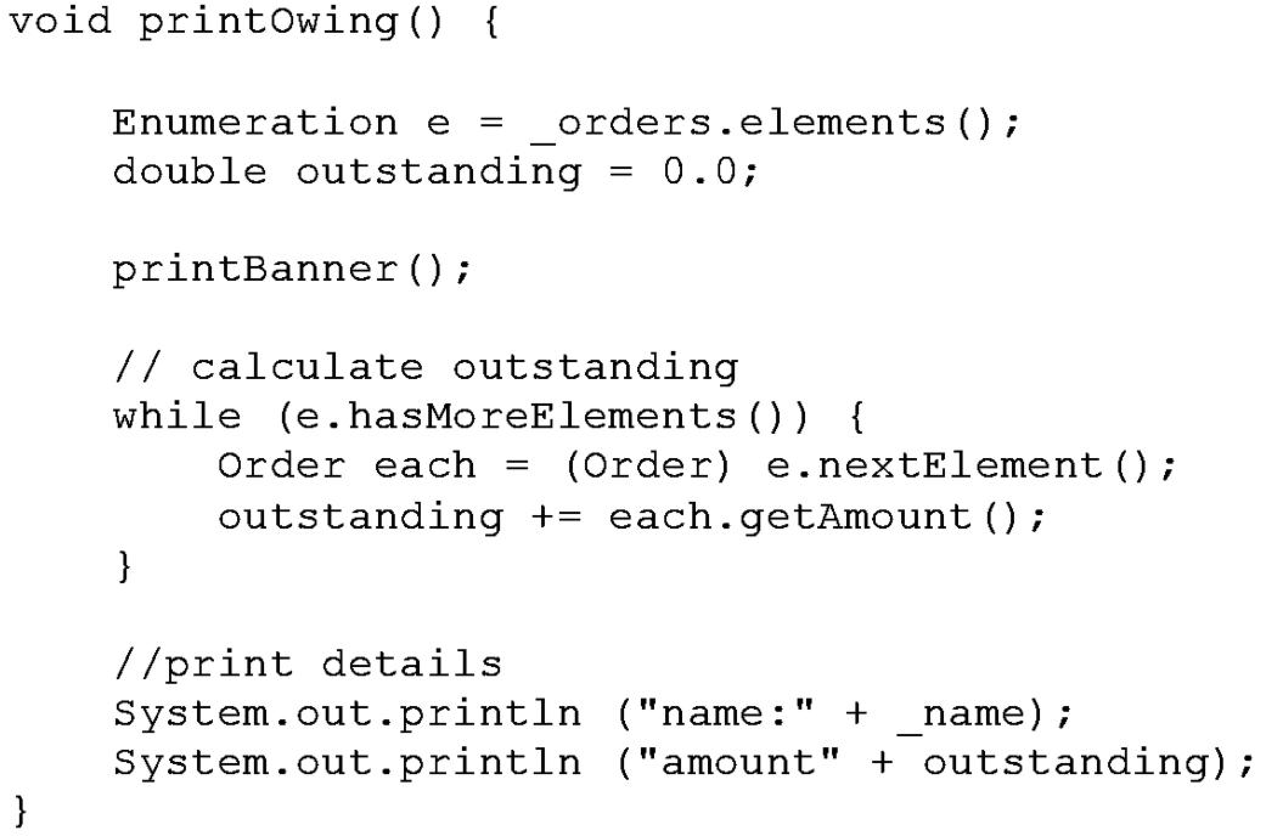
Composing Methods – Extract Method
Example: Using Local Variables
Extract the printing of details with a method with one parameter:

Slide 10
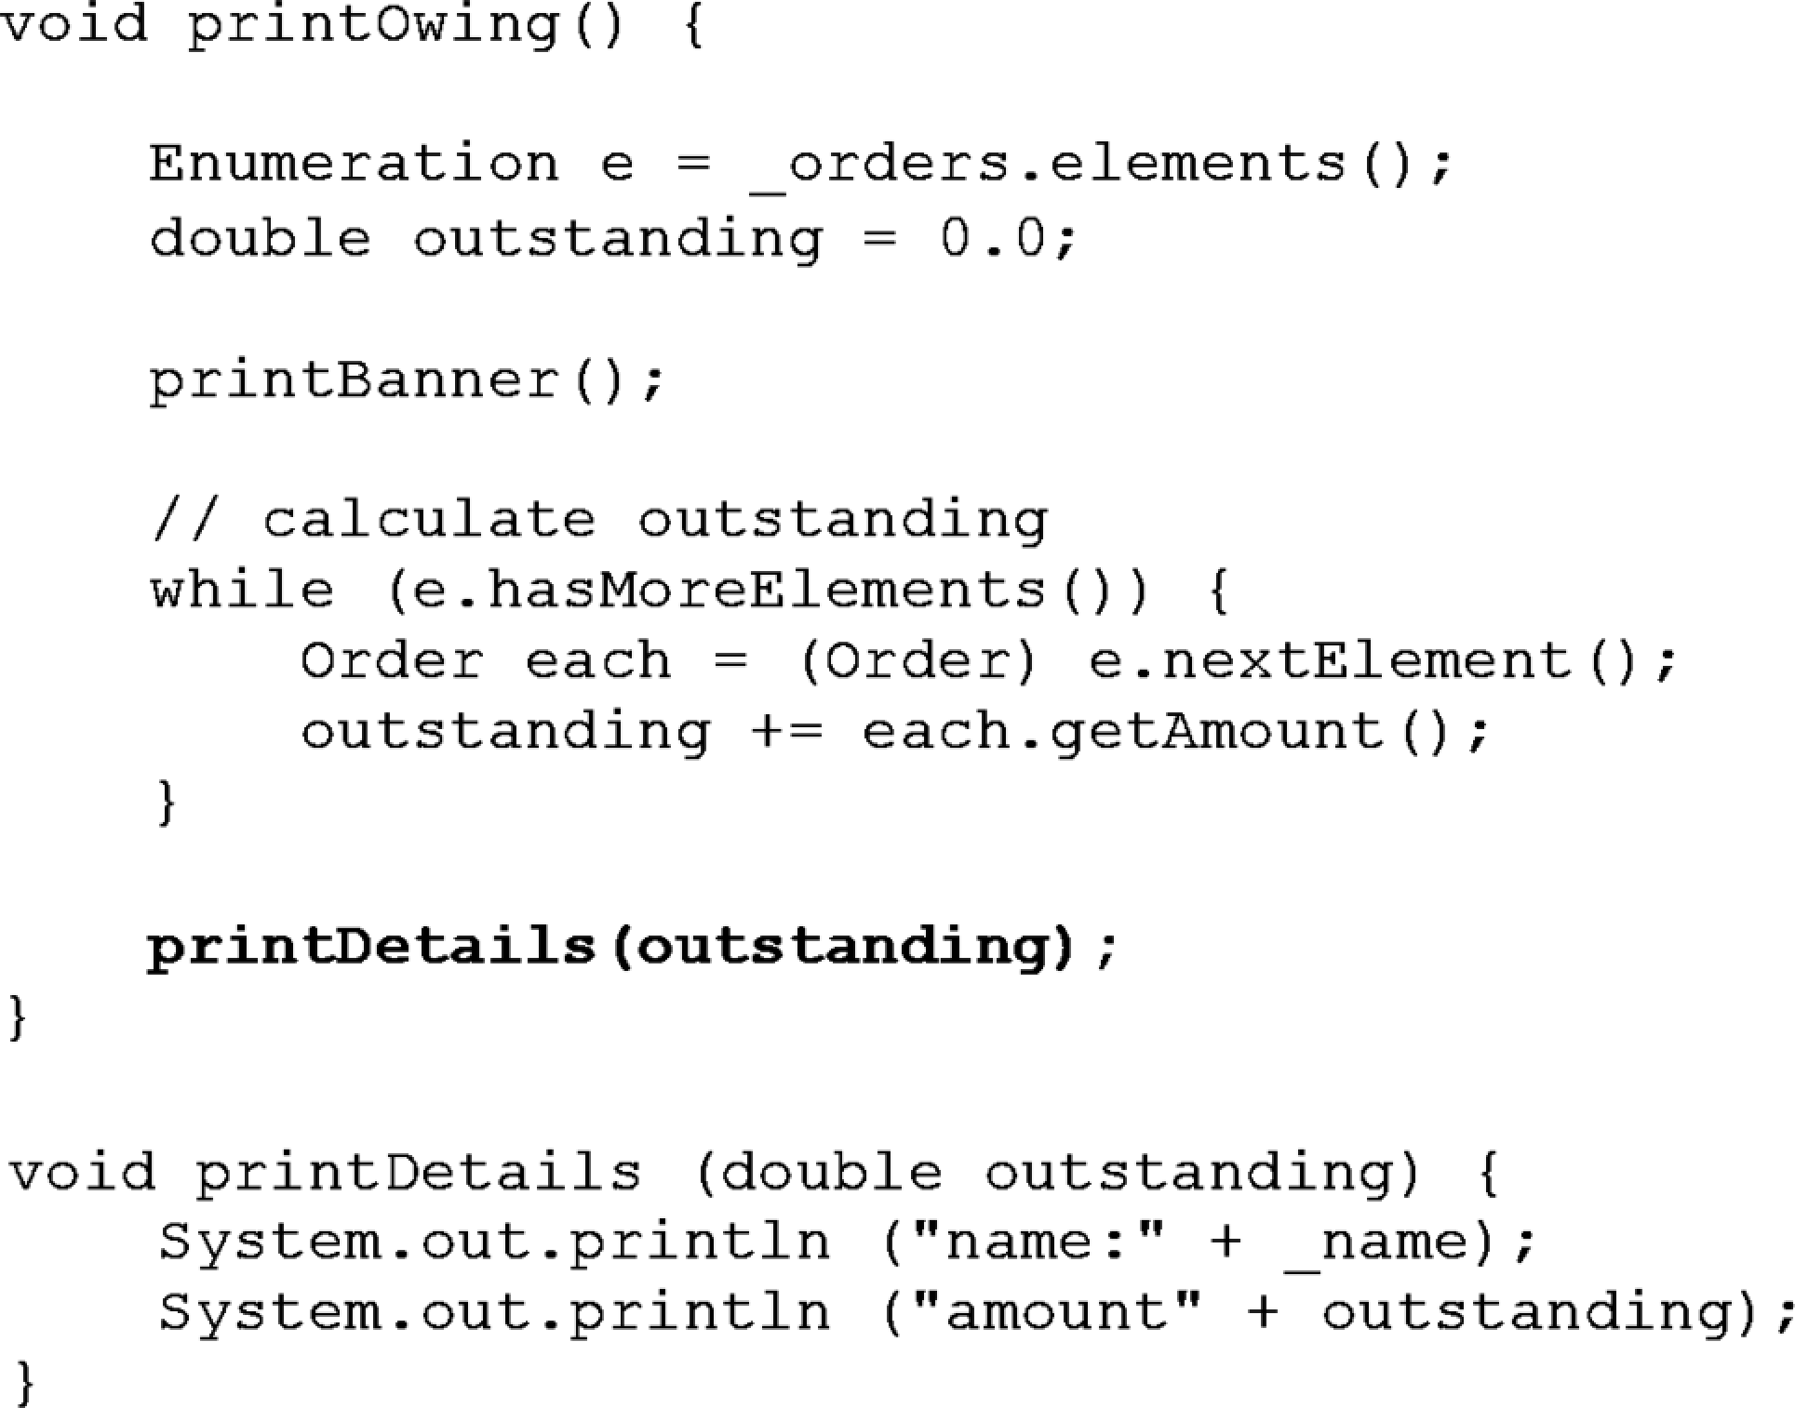
Composing Methods – Extract Method
Example: Using Local Variables
Extract the printing of details with a method with one parameter:

Slide 11
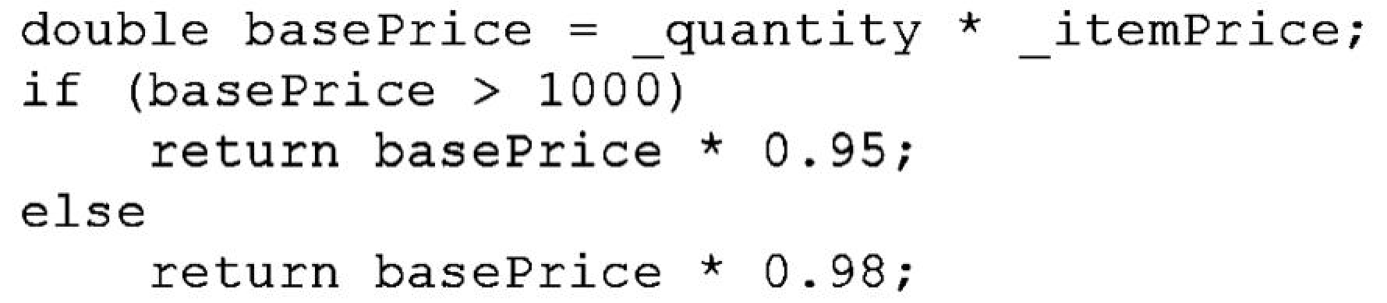
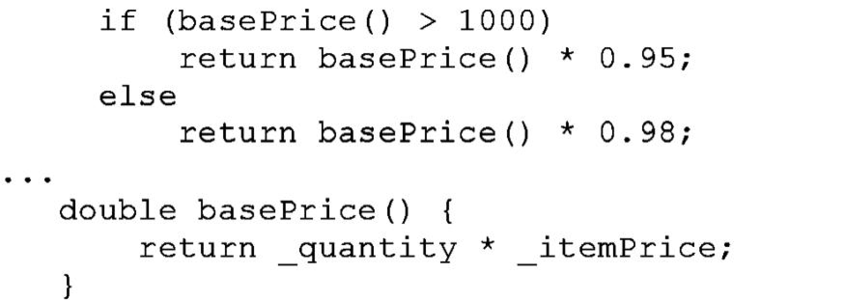
Composing Methods – Replace Temp with Query
You are using a temporary variable to hold the result of an expression.
Extract the expression into a method.
Replace all references to the temp with the expression. The new method can then be used in other methods.

Slide 12
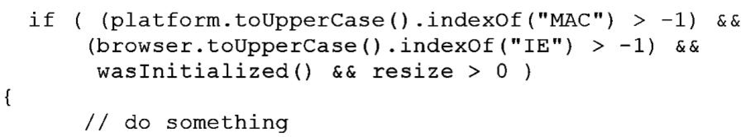
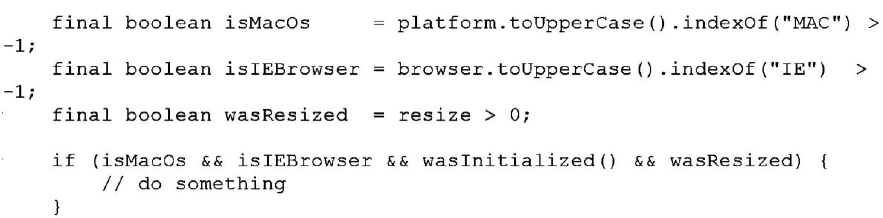
Composing Methods – Introduce Explaining Variable
You have a complicated expression. Put the result of the expression, or parts of the expression, in a temporary variable with a name that explains the purpose.

Slide 13
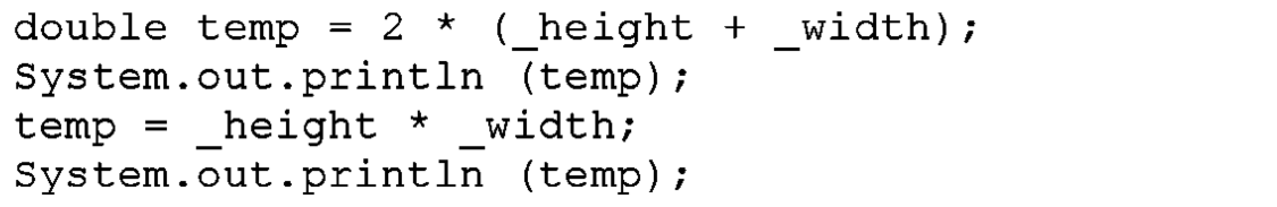
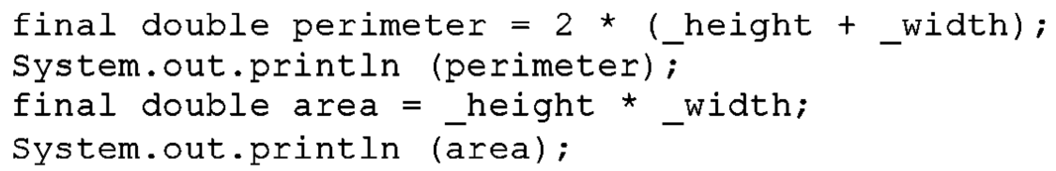
Composing Methods – Split Temporary Variable
You have a temporary variable assigned to more than once, but is not a loop variable nor a collecting temporary variable.
Make a separate temporary variable for each assignment.

Slide 14
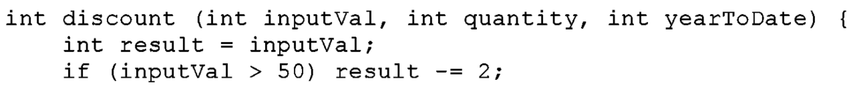
Composing Methods – Remove Assignments to Parameters
The code assigns to a parameter.
Use a temporary variable instead.

Slide 15
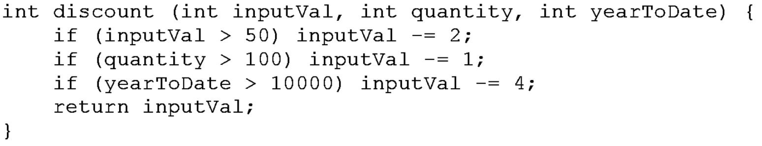
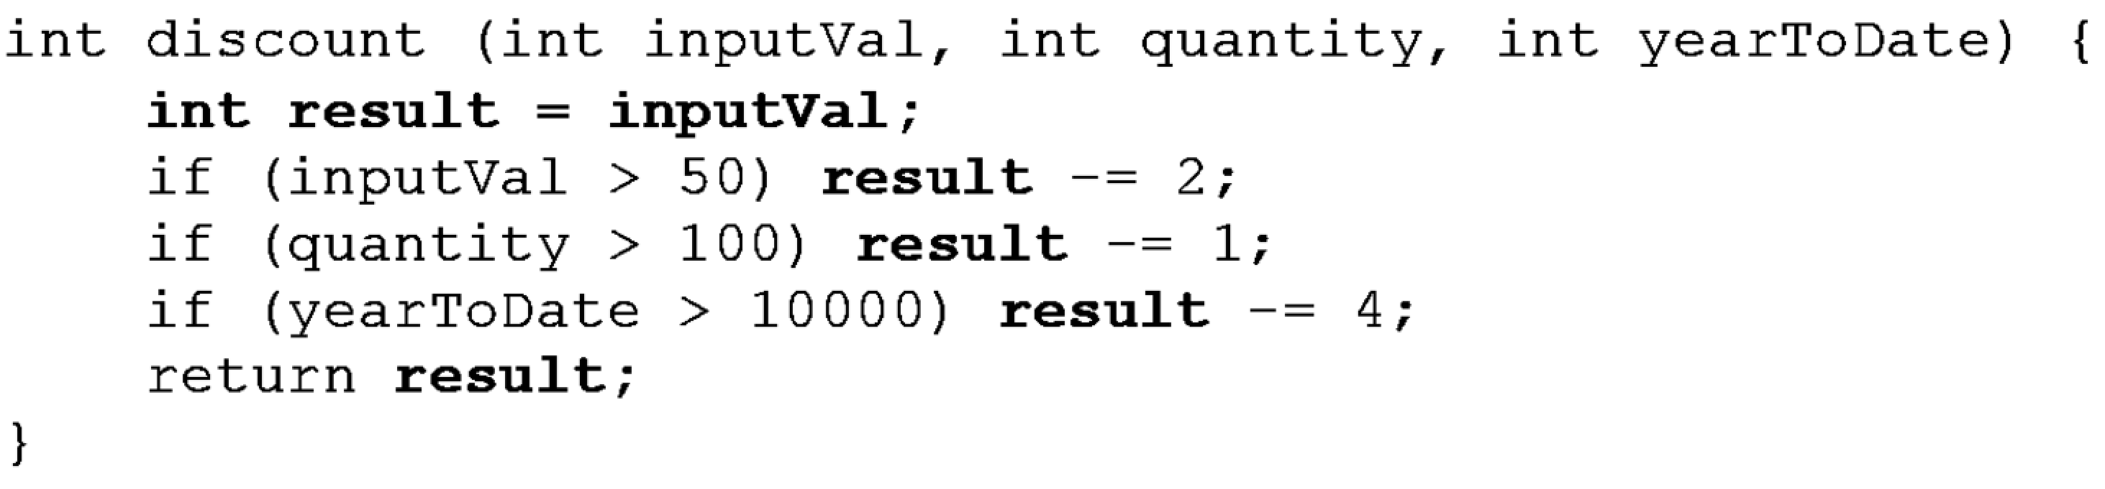
Composing Methods – Remove Assignments to Parameters
Example: Start with the following simple routine:

Slide 16
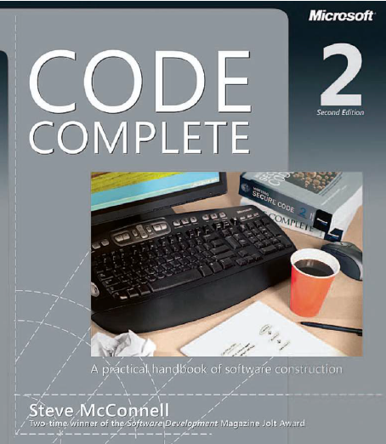
Reading
Code Complete: A Practical Handbook of Software Construction, 2nd Edition, Steve McConnell.
Chapter 26

Slide 17

Any questions? ​
Please feel free to raise your hands and ask.

